Slide 1

Weekly Meeting
June 26, 2023

Slide 2
Last week
Latency Sensitive Applications
Simulations
to show how the size of the backup model you used can affect availability and latency
Have some assumptions
size of the primary model and backup model
for each node, what kind of models can we fit

Slide 3
Fault Tolerance
permanent faults
“may lead to the unavailability of the system for extended time periods until it is repaired or replaced. In real-time embedded systems that need to be operational continuously, permanent faults can only be dealt with extra processors (hardware redundancy)”
”by taking advantage of the hardware redundancy provided by the primary and spare processor, can tolerate at most one permanent fault. “
transient faults
often induced by electromagnetic interference and cosmic radiations

Slide 4
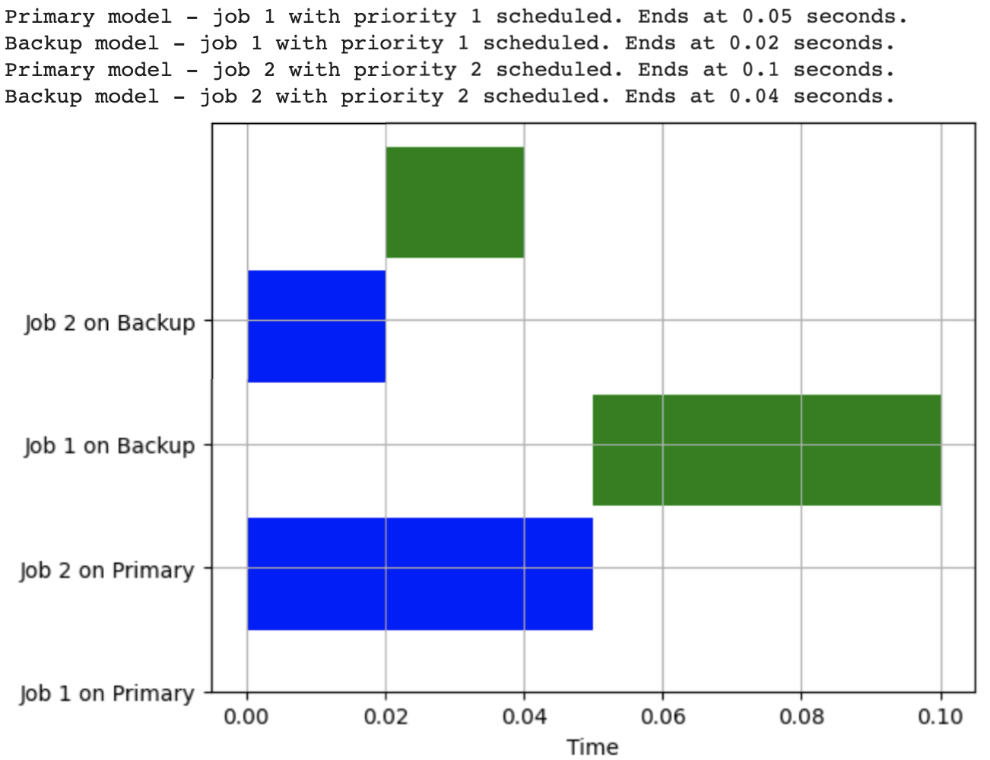
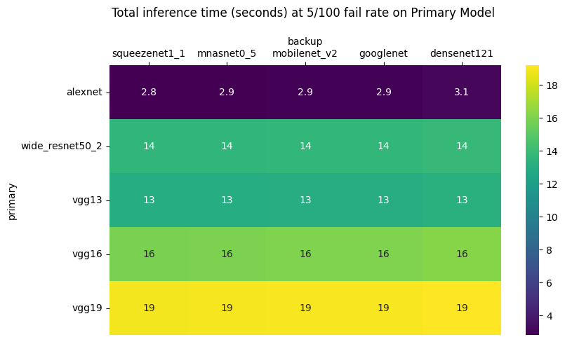
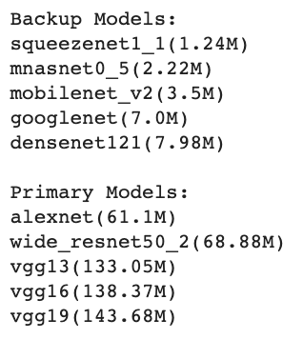

How does the backup model selection affect latency and energy?
1 node: Jetson Nano
2 models
1 task
should have 2 nodes
.

Slide 5

Energy Efficiency vs N number of failures
Energy Consumption (Joules) / Accuracy %
A lower value of this metric is typically desirable

Slide 6
Efficient Pairing
Backup System: For every model running on a node, there is a corresponding backup node that can take over the operation if the primary node fails. This system ensures that the operation will continue running without significant interruptions.
Model Pairing: To ensure efficient system operations, it's crucial to determine how to best pair models together on a node. Factors to consider include the size of the models, the node's capacity, and the potential impact on system reliability.
Node 2
Node 1
Model 1
Model 1
Model 2
Model 2

Slide 7
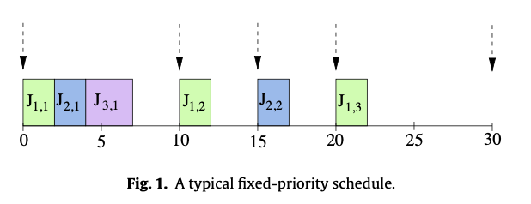
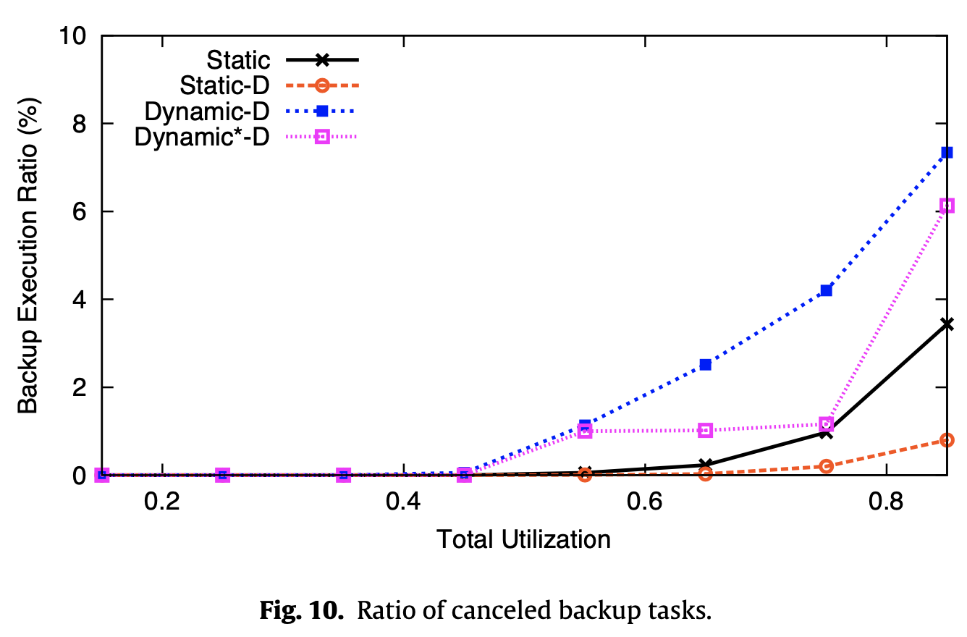
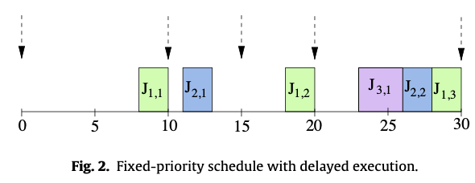
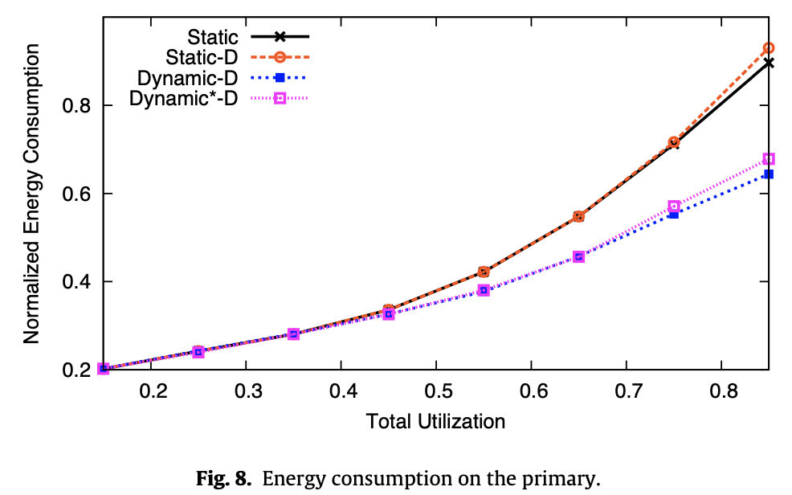
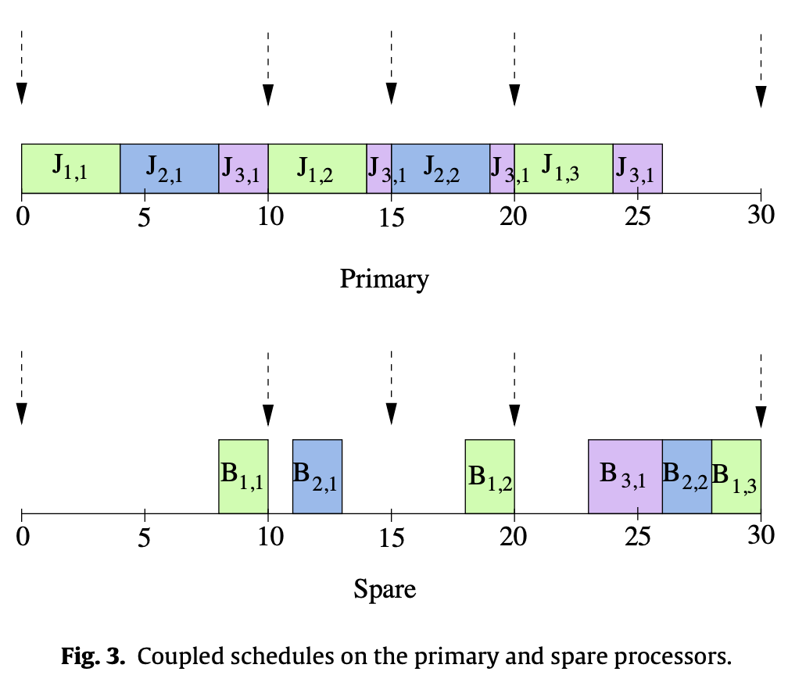
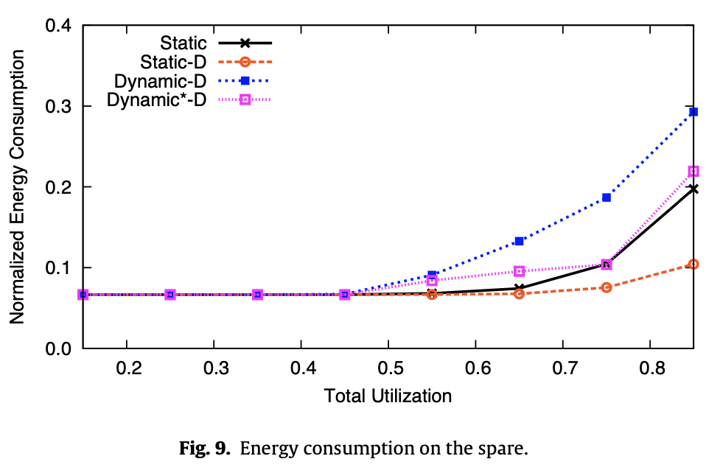
Paper #5: Energy-aware standby-sparing for fixed-priority real-time task sets
proposes a dual-queue mechanism to delay the execution of backup tasks and minimize overlap with main tasks.
Tested static vs dynamic delaying methods
our solution is seen to save more energy at medium to high load values despite deploying the additional spare processor, while offering clear advantages in terms of reliability.
Results: The experimental evaluation shows that the proposed schemes effectively reduce energy consumption while maintaining system reliability
Improved Reliability: The study demonstrates that the standby-sparing scheme provides fault tolerance by executing backup tasks on a spare processor
Energy Efficiency: The dual-queue mechanism maximizes the delay of backup tasks, allowing for the cancellation of unnecessary backup executions and reducing energy consumption in the system.

